Slide 1
Morse Click
-- --- .-. … . -.-. .-.. .. -.-. -.-

Slide 2

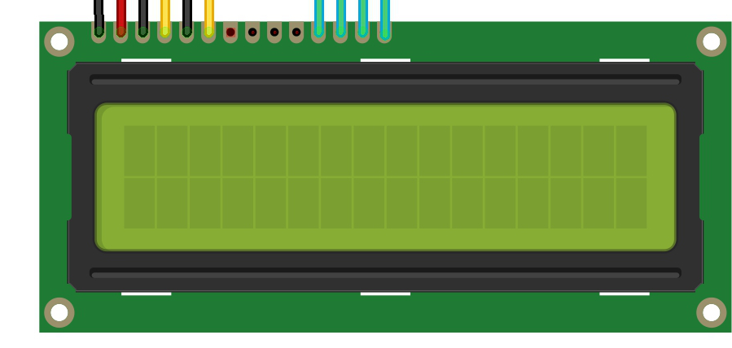
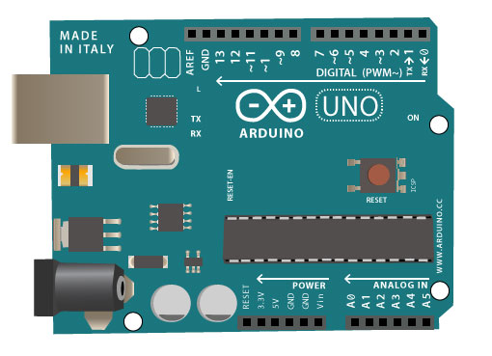

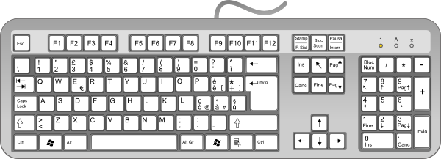
Functions
Convert PS/2 Keyboard clicks into morse code
Send whole statement to morse code after Click Enter
send SOS Signal without keyboard
SOS

Slide 3
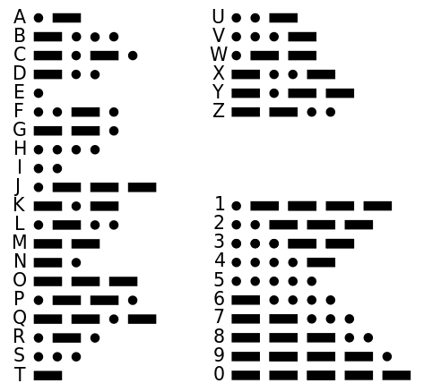
Morse Code
Ö - - -·
Ä · - · -
Å · - - · -

Slide 4
Features
LCD screen
Change Morse mode with Page Up / Page Down
Change the phase period Arrow Up / Arrow Down
Change the tone frequency Arrow Left / Arrow Right
One button two functions: one click for STOP
5 second hold for SOS

Slide 5
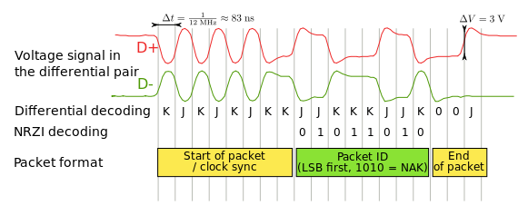
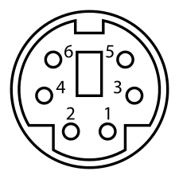
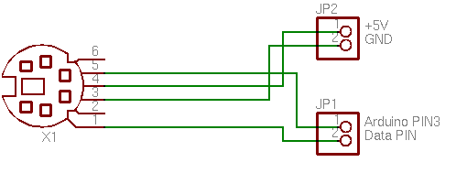
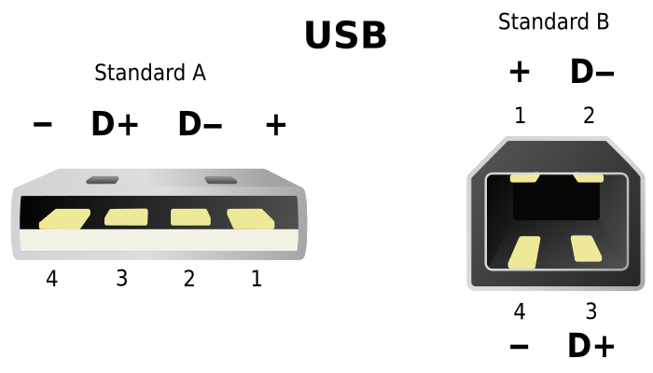
challenges PS/2 vs USB

Slide 6
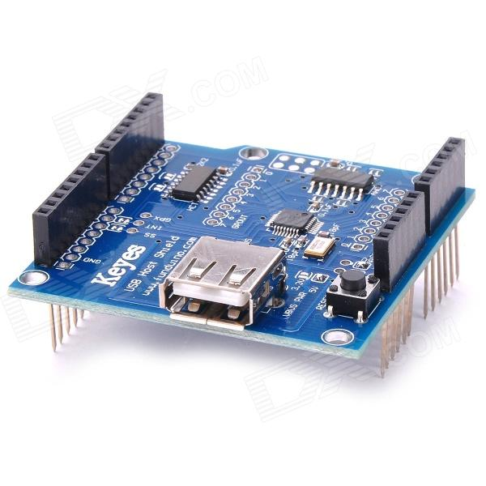
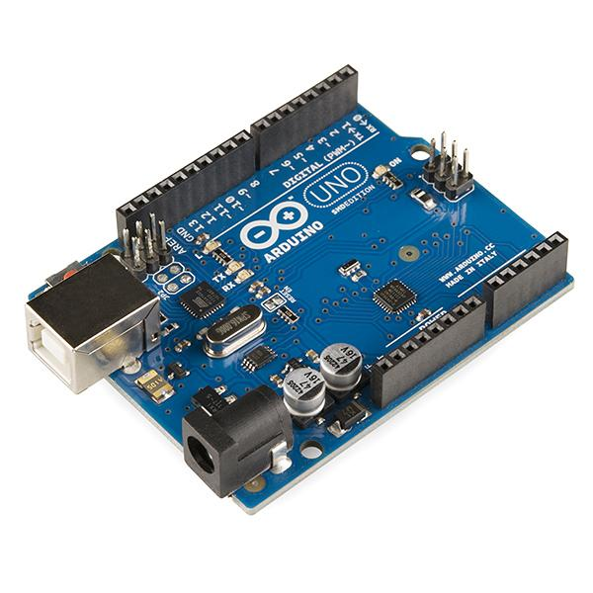
challenges PS/2 vs USB
$
>
USB Host Shield
350:- SEK
Arduino Board
215:- SEK

Slide 7
challenges: Support Ö Ä Å
LCD does not support special latin letters by default
CreateChar
byte OO[8] = { //Ö
B10001,
B00000,
B01110,
B10001,
B10001,
B10001,
B01110,
};
lcd.createChar(2, OO); //Ö

Slide 8
challenges: Buzzer interfere the LCD
For some reason the Buzzer (small speaker) was interfere the LCD
Solution:
connect 220 resistance and avoid long cable
or
locate the buzzer far from the LCD

Slide 9
challenges: Only 2 interruptible pins
Arduino UNO has only 2 interruptible pins 2 & 3
Pin 3 is already used for PS/2 Keyboard.
Pin 2 used for one buttons used for 2 functions: STOP and SOS
quick push for STOP, Hold for 5 sec for SOS

Slide 10
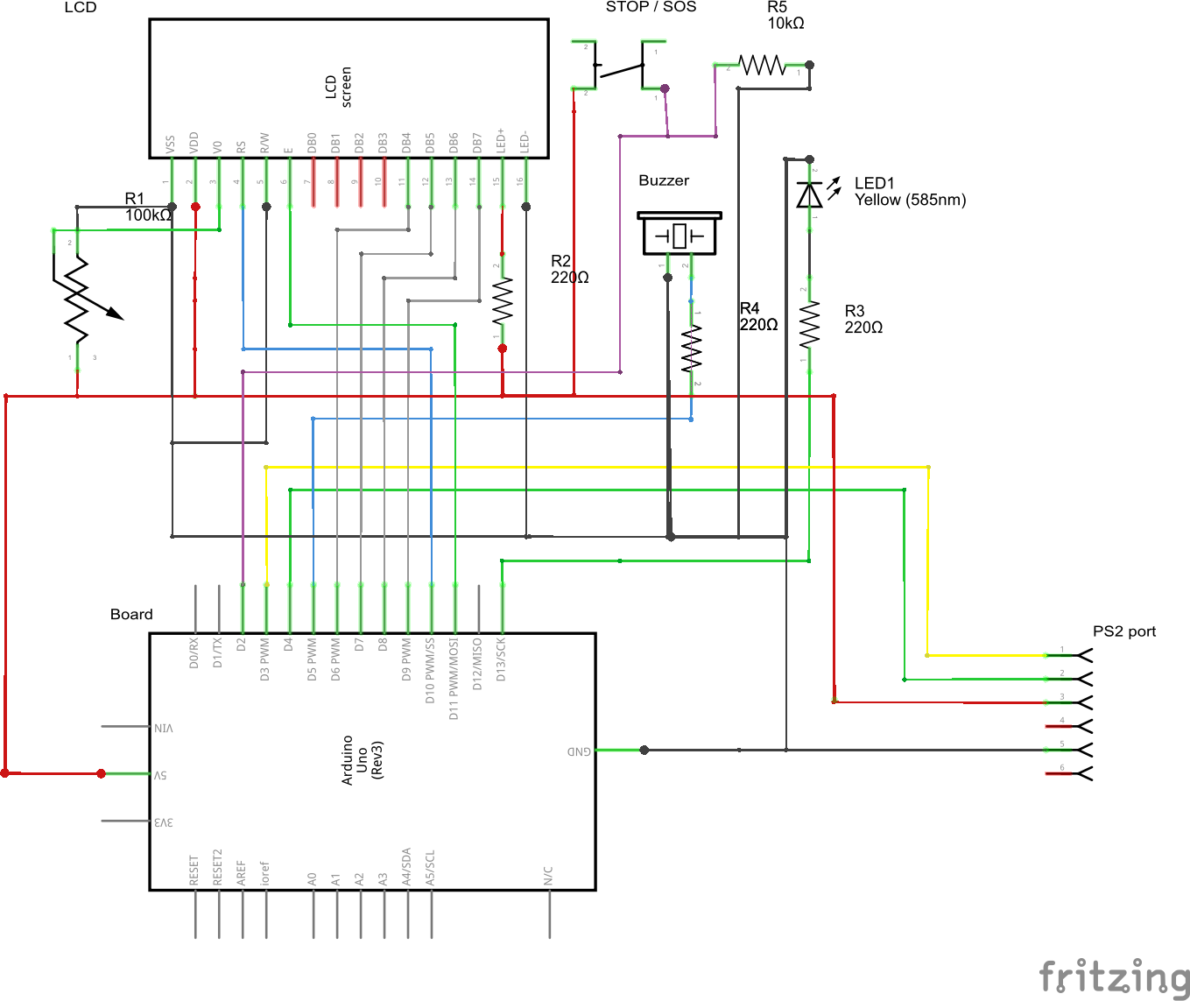
Schema
Material
Arduino UNO
LCD 16x2
3x Resistance 220Ω
1x Resistance 10KΩ
PS/2 female port
30 lines breadboard
Buzzer
LED
Push Button
Potentiometer
PS/2 Keyboard

Slide 11


Slide 12

Q & A

